Slide 1

Accident recognition system
GonÇalo neves
Alexandre RODRIGUES
Carlos valle
Jesus lamoneda

Slide 2

PROBLEMS
STUCK IN TRAFFIC BECAUSE OF AN ACCIDENT?
NOT BEING ABLE TO CALL FOR HELP?

Slide 3

SOLUTION
OUR IDEA!

Slide 4

MORE ASSISTANCE MORE SAVED LIVES
OUR SERVICE

Slide 5
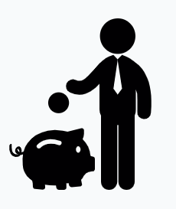
LESS VIGILANCE REQUIREMENT LOWER COST
OUR SERVICE

Slide 6

IMPLEMENTATION
WATSON VISUAL RECOGNITION
NODE-RED

Slide 7
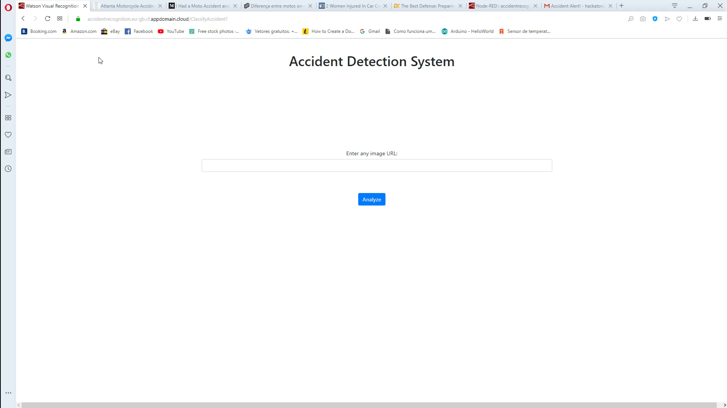
CAR ACCIDENT

Slide 8

MOTORCYCLE ACCIDENT

Slide 9

NO ACCIDENT

Slide 10

ANY QUESTIONS?

